Slide 1
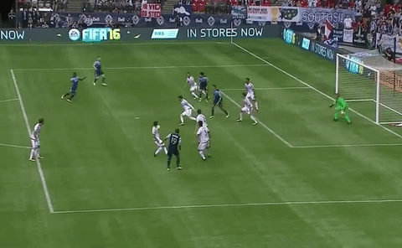
Golazo v0.92
Scoring the perfect goal

Slide 2
Terminology
Value – what your customer believes the product or service is worth
Cost – what you spend ($, effort, etc.) to produce or maintain it
Waste – subset of cost spent that did not contribute to value
Delay – Calendar time where production is stalled
ROI – Value / Cost
Oversimplistic Rule of Thumb:
Ask: would I do more of it, if I could?
  Yes: it is value.
  No: ask, can I do less of it?
    No: it’s a cost
    Yes: it’s a waste

Slide 3
Begin with the End
The Goal:
Add value
Reduce Calendar Time
Reduce Engineering Time
How do we do this
Deliver timely solutions to actual customer problems
Identify and remove causes of delay/waste
Leverage the knowledge/strengths of the team
Automate/Remove recurring costs

Slide 4


Model Comparison
Predictive
Plan Driven
Adaptive
Requirements fixed
Uses analysis over feedback
Big design up front
Architecture pre-determined
Estimates given up front
Requirements treated as equal priority (in/out)
Planning driven
Requirements flexible
Uses feedback over analysis
small design up front
Architecture evolves
Estimates constantly revised
Requirements prioritized by value
Notes:
Predictive system is one where scope, deadline, etc. are determined up front. Afterwards, following the plan is significant more important than the original objective. Customer feedback not relevant.
An Iterative system is a predictive system where activities are repeated in smaller iterations. The end objective may be vague or considerable complex. Provides some opportunity to evaluate feedback.
An Adaptive system is one that responds quickly to changing goals, plans, etc. A lightweight plan is constructed and adapted quickly based on feedback. Constant customer feedback is critical.
An Interrupt-driven system is one where [something] reports state changes which results in new assignments and workloads.

Slide 5
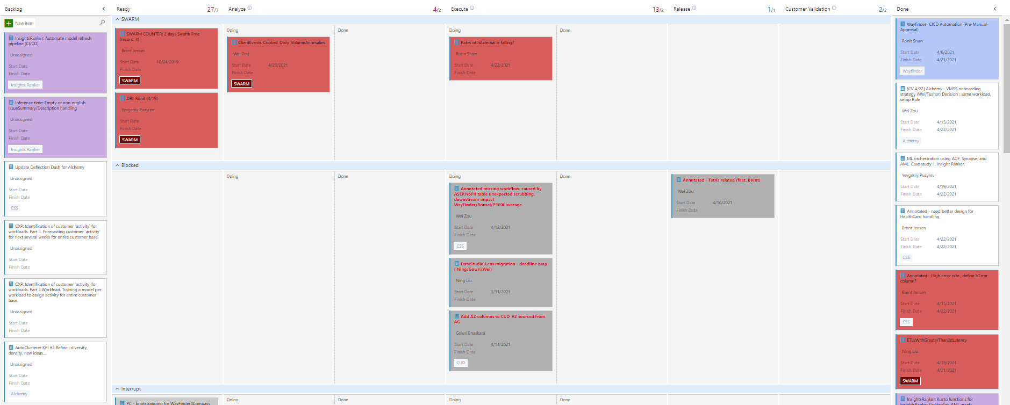
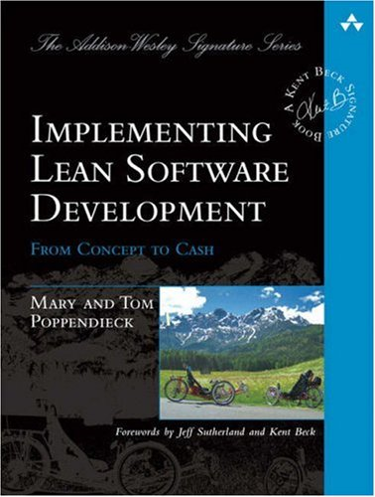


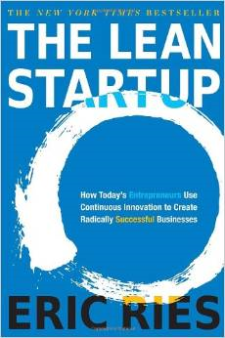
What is Golazo?
A hybrid of Kanban and Lean Agile
Emphasis:
Teamwork
Biz value
Scale resources
+

Slide 6
Key differences from pure Kanban
Removing bottlenecks on Knowledge Sharing
Encourages Handoffs & Pair Programming (esp for people new to an area)
Encourages a sense of team (bans “owners”)
  Even better with StrengthFinders framework
Introduces the Customer Validation column to emphasize Biz Value

Slide 7
Key Observed Outcomes
n
Project
Shift towards zero timeboxing
Tolerance for innovation & experimentation
Highly tolerant of schedule interrupts
Product Design
Encourages modular, reusable code
Future feature development easier
Maintenance cost easier
People
Liquid labor pool
Drives whole team accountability
High Morale
Acceleration via knowledge sharing
Business
Reduces time spent on features/bugs customers don’t care about.
Value is optimized for customer
Notes:
NS

Slide 8
Key Parts
b
Taskboard, Tickets & Design Documents
People Roles
Meetings
Execution Process

Slide 9
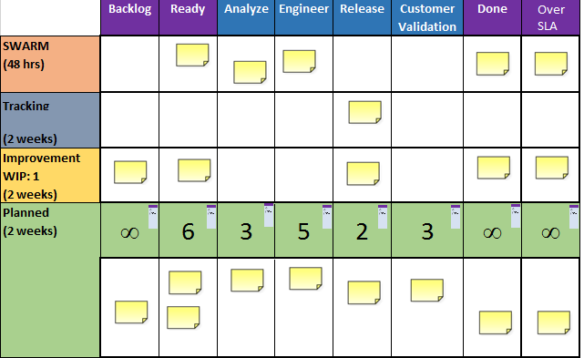
Key Parts
Taskboard
b
Columns
Work Not Started
Work in flight
Work Completed
Rails
Exit Criteria
SLA
WIP Limits

Slide 10
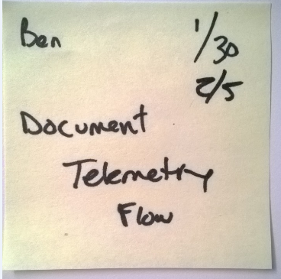
Key Parts
Story Tickets
b
TFS ID:
Find acceptance criteria there
Shepherd
Start/End Dates
Not Started
Completed
Depends on this – remove when clear
Ticket Color indicates Scenario

Slide 11
Analyze Doc
Different templates for Swarm from the other rails
n
SWARM
Customer Impact
Dependencies
Mitigation
Root Cause
Repair
Design Review
Plan
Elevator Pitch
Ready Validation
Customer Value
Acceptance Criteria (DoD)
Acceptance Test
Dependencies
Design Approach
Task + Aux Task List
Estimation
Design Review

Slide 12
Key People – Coach
s
Runs standup. Probably most important role.
Owns the Ready column and making sure work is Ready.
Focuses on team velocity without violating any of the policies.
Assures the board represents truth
Encourage folks to work on their passion.
Encourages pair programming to unblock
Owns WIP limits and SLAs
Records Ticket Data & analyzes trends
Blocks standup distractions

Slide 13
Key People – DRI
s
Responsible for:
  Identifying issues/SLA violations that negatively impact customer.
  Translates above into SWARM tickets
  Makes sure Swarm tickets get owned by team.
  Project: DRI must start & complete some project to make next DRI’s job easier.
Whole team rotates through DRI role (even management).
Week long duty.
New DRI starts on Tuesdays.

Slide 14
Key Meetings
Standup
Retrospective
GOAL - What do we finish next?
NOT A STATUS REPORT EVENT
Daily – 30 Minutes
Standup happens on time
GOAL - Team learns together
NOT A POST MORTEM
Weekly – 1 hr
Takeaways
  What to celebrate
  What to change

Slide 15
Execution
b
Deliver Fast
Eliminate Waste
Defer Commitment
Build Quality In
Create Knowledge
Respect People
Optimize the Whole

Slide 16
Standup - Rules
s
DRI starts standup
  Discussion is ticket by ticket, not person by person
Key questions per ticket
  What remains to move your current ticket move to the next column?
  Who’s knowledge will accelerate?
  Are there critical learnings that need to be shared?
  Do we need to schedule a follow-up?
Coach
  Assures no policy violation
    WIP
    Exit criteria
    SLA
  Resolves IDLE people
  DRI assignment
  Handoff considerations
    Funding Swarm immediately
    Pending OOF

Slide 17
PULL (don’t push)
What do we finish next? This IS a team sport.
s
Rules for IDLE people:
Fund SWARM.
  If no one is idle, then interrupt other work in flight
Idle people start at right most column and help (where practical) move the ticket forward.
If no help is needed, they move left to next ticket and try to help there…
This continues until they are not idle or they get to the ready column.
They may pick *whichever* ticket in the ready column they want.
  Tickets taken from Ready get person’s initials and start date written
  When tickets get to done, end date gets added.
Notes:
NS

Slide 18
The Rails
b
Rails help to dedicate funding.
  Explicit funding
  new rail for handling workload variation
Plan – primary rail. Team’s success is based on this rail
Interrupt – Creates official means to allow for changes in flight. Also, limits funding.
Improvement – Creates means to fund needed architectural runway.
Tracking – visualizes those things you expect a dependent team to release soon so some other ticket can move
OOF – visualizes when team members will not be present, so you can do handoff before departure.
Required:
SWARM – SLA: 48 hrs
Improvement – WIP: 1
Plan – SLA: 2 weeks
Optional:
Tracking – SLA: 2 weeks
OOF – No limits
Interrupt – WIP: 1
NOTE: Coach owns ready EXCEPT for improvement

Slide 19
More on Swarm– How bugs are handled
s
SWARM is an issue with customer impact in a supported service/feature that as a result of our action or inaction causes a lack of trust/faith in us.
SWARM tickets can be an indicator of going TOO fast
Swarm – make the decision *now* and fund *now*
  Either
    Fix or revert
    Add to backlog if SLA can’t be met
    Punt until it is a problem (throw the ticket away)
  SWARMs are funded immediately by whole team. Stop and Fix now.
Notes:
SD

Slide 20
The Columns
Explicit Exit Criteria
n
Backlog
Consensus that ticket represents most immediate business value
Ready
Has Owner and start date
Analyze
Analyze Doc Done
Engineer
Released
Customer Validated
Done
Above is signed off by 2 people (Design Review (DR))
All required tests pass
Code Checked in
Code integrated into solution without Mocks
Code officially released
Customer validated as Done
New Stories added to backlog
Relevant Team learnings captured at retrospective
Code review signed off by 2 people
Passes Acceptance review
Acceptance Criteria Defined and signed off by PO
Notes:
NS

Slide 21
Limiting Work In Progress
n
People: 1-2 tickets (DRI duty counts as 1)
Columns: as defined (Execution columns sum = 1.5 * Team size)
Rails: as defined
Why?
Reducing delay MORE valuable than fully utilizing resources
Efficiency != Speed. You need capacity to go fast.
Multi-tasking major source of delay
Reduces complexity
Visualize and eliminate bottlenecks

Slide 22
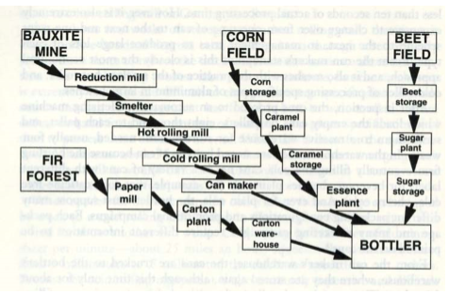
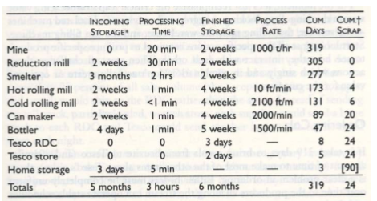
Coca-Cola Value Stream Mapping
b
Aluminum pick up and placed down over 30 times
99% of the time: being stored.

Slide 23
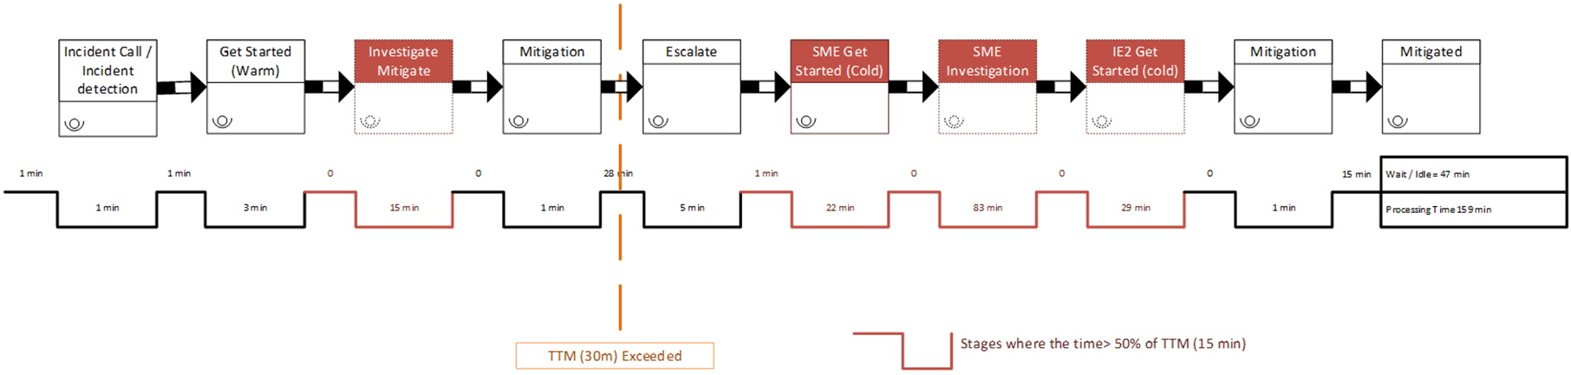
Weekly Retrospective
Goal: 2 Celebrate items and 2 Change items minimum
Create a histogram by calendar duration for each rail and place Done tickets
For Waste Tickets, ask: What could team have done differently to come to same conclusion sooner?
For tickets over SLA
  Draw the Value Stream Map and ask: What could the team have done differently to get to done sooner?

Slide 24
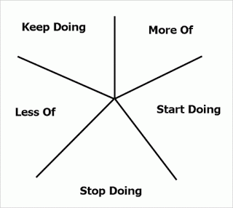
Starfish retrospective - Quarterly
Everyone has 10 minutes
  Create 2 tickets per each category
  Mark the category on the ticket
    Stop Doing
    Start Doing
    Keep Doing
    Do less
    Do more
Then regroup similar tickets together
Then based on ticket count, create an action plan to address the new grouping
Notes:
Hide – cover How and Why?

Slide 25
Metrics and Measures
b
Watch and trend the following:
ROI – (economic value produced)/(Actual job size)
Throughput – Count of tickets started each week
Cycle time – “average” time for a ticket to close
Notes:
BJ

Slide 26
Archive

Slide 27
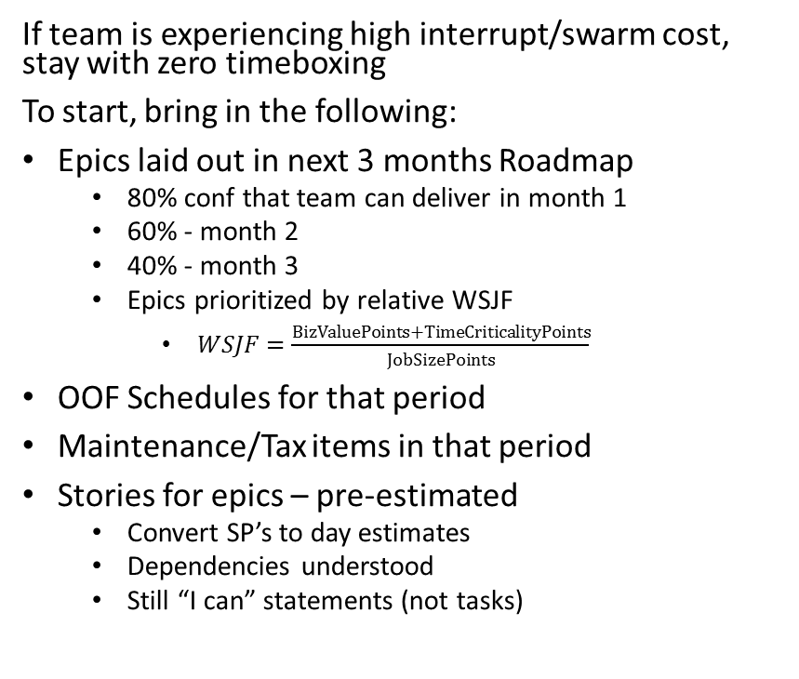
Sprint Fitting – Golazo in a sprint paradigm
If team is experiencing high interrupt/swarm cost, stay with zero timeboxing
To start, bring in the following:
Epics laid out in next 3 months Roadmap
  80% conf that team can deliver in month 1
  60% - month 2
  40% - month 3
  Epics prioritized by relative WSJF
    $WSJF=\frac{BizValuePoints+TimeCriticalityPoints}{JobSizePoints}$
OOF Schedules for that period
Maintenance/Tax items in that period
Stories for epics – pre-estimated
  Convert SP’s to day estimates
  Dependencies understood
  Still “I can” statements (not tasks)
3 months = 6 sprints of 2 weeks
For each sprint, assign capacity
  8*(team size) – adjusted as needed
    Optimize for pulling stories forward
    Example: 7 people = 56 days, then rounded to 50
  Place OOF and Tax tickets into correct sprint and subtract capacity
Using roadmap as guide, place stories into sprint
  Fill sprints to capacity in Epic priority order
  Be realistic about dependency ordering
  If story doesn’t fit in current sprint, break into smaller stories or move it to next sprint
  Adjust
    If 1 or 2 sprints are over by 1 or 2 points, that’s ok.
    Pull smaller, independent less priority stories forward if they can help utilized a sprint better
  Ask team to look at sprint plan as whole
    Who doesn’t fully commit to this plan and why?
    Discuss and adjust until full committment

Slide 28
Prioritization Meeting – when your small team supports a large number of others
Scheduled with regular cadence (weekly)
Decides what tickets are in the Ready column
Ideal: it’s all of your customers in 1 room.
Narrative: “Hey guys, this week my team completed ticket X and Y. In addition, they have started work on 3 tickets (A, B & C). That means there’s room in the Ready column for 3 tickets. Which 3 are the next that *you* agree add the most business value?”
Customers are welcome to do *whatever* changes to the Ready column they would like. They do not have pick backlog items.
They *only* have to agree that the items in the list represent the current most valuable to the business.
You may need to be prepared to facilitate this to closure.
Ready column does *not* have to be filled, but can not exceed WIP.
“But my ticket is urgent and it did not get choosen!”
  Enable “drive-by contribution”

Slide 29
Define WIP
b
Work in Progress – Multi-tasking is 2nd largest systemic waste
All Work Columns *must* have WIP value
Queue columns *should* have WIP value
Ideal is 1-2 tickets per person
  1 is better
  DRI/FTOC duty counts as a ticket
  To start, total Column WIP *should* add up to a max of 1.5*TeamSize
    (not counting Backlog, Ready, or Done)
When done right, this will show you where the bottleneck is in your process.
  If you aren’t seeing it, reduce WIP in some column
This will also create free capacity on your team. You need capacity to go fast.

Slide 30
Fill the backlog
b
Use ticket colors to represent something meaningful
  Possibilities:
    Architectural layer
    Type of work (swarm, interrupt, maintenance, etc)
    Scenarios
    To start, put existing in flight work into the appropriate column
Recommend Agile Estimation methods for planning
Print out tickets and get them on the board.
Determine readiness via INVEST
Independent
Negotiable
Valuable
Estimable
Small
Testable
Notes:
Change to Analyze discussion

